Slide 1
Html list generator concept doc
Shachar oz

Slide 2
Need
No css creator based on graphic design.
You always need a human eye to look on the design and decide how to do it.
High dependency on framework: bootstrap/ foundation/ others. Each framework sets classes and css styles that you can use, but you have to be an expert in order to effectively use it.
And above all, graphic designers always change their mind. Which might cost the developer with extra hard work replacing the hard coded html code, while keeping the real data safe.

Slide 3
Goal
Add your data
Upload all your data, divided into objects.
you actually create some sort of data base from your content
Data is saved in the same formation whatever design you create. Change the data – and the design automatically updates.
Design your item visually
Use real content: image, title, description, date, links, tags.
You can play with all the data fields you entered to the system.
Design graphically with a visual interface:
Edit images: crop, stretch, image effect
Write text, edit fonts and sizes, colors
Set date format
Define visual states (interactivity)
3 main states: Idle state; hover state; click state.
Maybe more?
See results in real time on the entire list
Option: select a design from other users
Option: set responsive visual state (according to the width of the parent list)
Embed the html code in your site easily
Generate the css file (and javascript if needed)
If depends on a framework, you get that too.
step-by-step instructions of how and where to place the code in your file to get it to work.
Share your design
If you want, you can share your design with the world

Slide 4
Use cases
Design the way a blog post is shown in the blog page.
Design a list of projects in portfolio. Or lectures; publications;
Great for any type of list / gallery of items that are presented in similar way.

Slide 5
Similar projects
Divshot .com – design static sites using bootstrap/ foundation frameworks
Wufoo .com – design forms

Slide 6
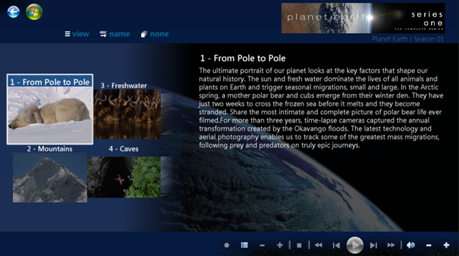
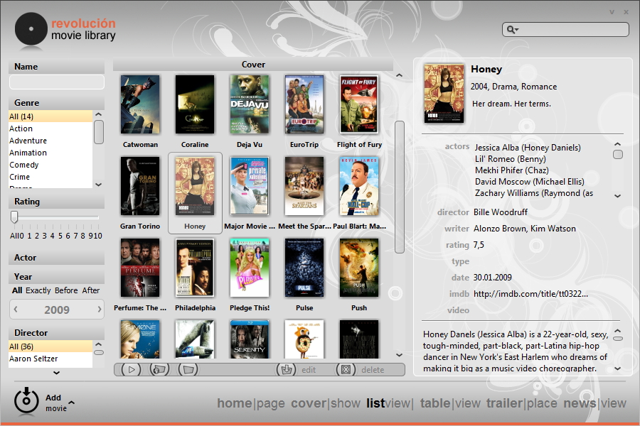
Sample designs

Slide 7
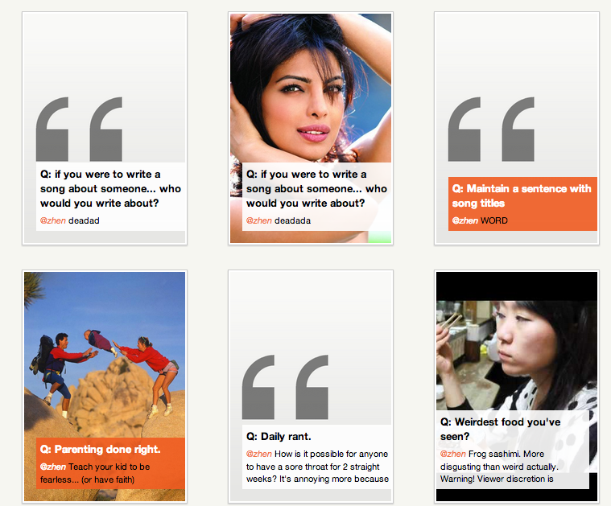
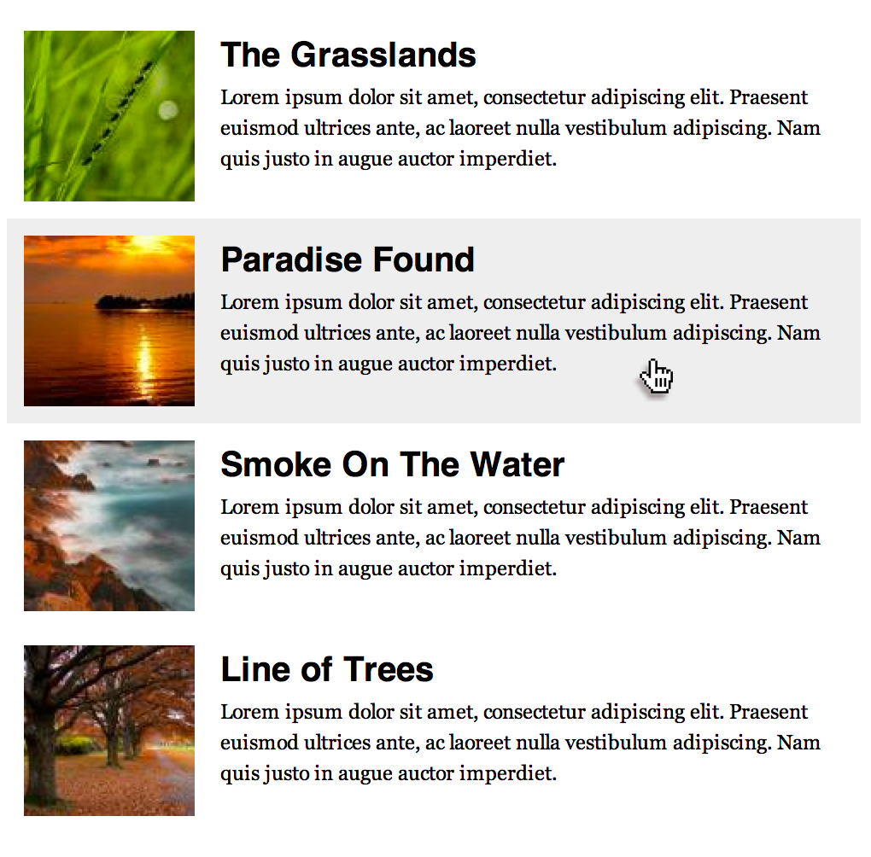
Sample designs

Slide 8
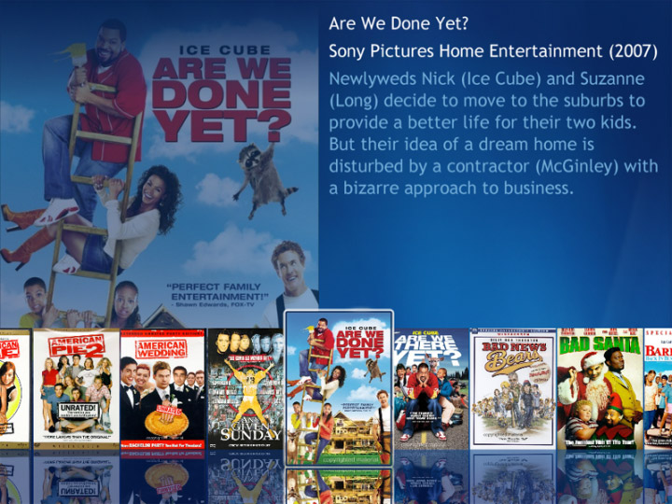
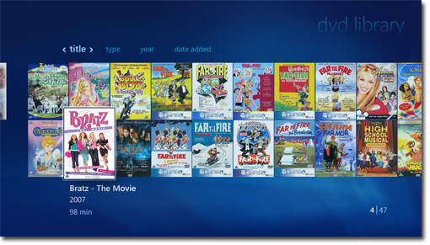
Sample designs

Slide 9
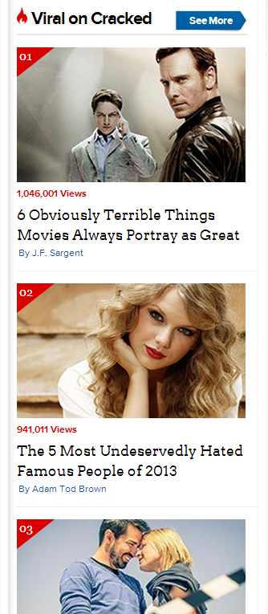

Slide 10
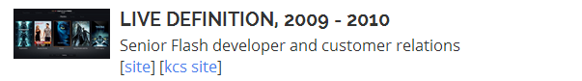
Currently available: image next to info
Requires bootstrap

Slide 11
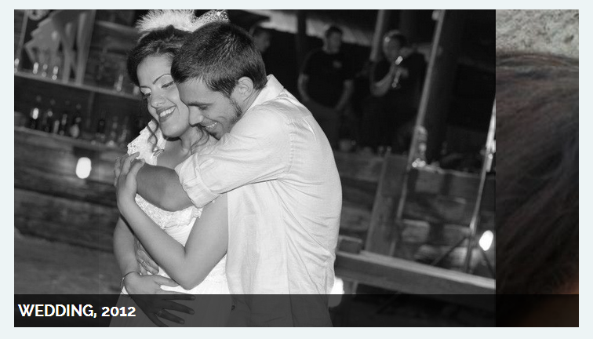
Currently available: image gallery slider
Requires Cycle 2

